Slide 1

ECE201R01 : Microprocessor & Microcontroller
Unit I: 8086 - Memory Segmentation
8086 - Memory Segmentation

Slide 2
Acknowledgement
The materials in the power point slides presented here are taken from one or more of the following reference books
I sincerely acknowledge the authors and publishers of the reference books for using them for my lectures
The purpose of these PPT materials are only for the benefit of the students and not for sale
8086 - Memory Segmentation

Slide 3
References
Acknowledgement
William Stallings, “Computer Organization and Architecture Designing for Performance”, 10th Edition, Pearson, 2016.
Krishna Kant, “MICROPROCESSORS AND MICROCONTROLLERS: Architecture, Programming and System Design 8085, 8086, 8051, 8096”, PHI, 2014.
Nilesh B Bahadure, “Microprocessors and the Pentium Family”, PHI, 2010
The 80x86 Instruction Set,
https://www.plantation-productions.com/Webster/www.artofasm.com/DOS/pdf/ch06.pdf
8086 - Memory Segmentation

Slide 4
Memory segmentation
Memory is divided into a number of parts called segments
In the 8086, the 1 MB physical memory is divided into four segments: Code Segment, Data Segment, Stack Segment and Extra Segment
Each segment has memory space of 64 KB
Each segment is addressed by a 16-bit segment register as follows:
  CS—Code Segment Register
  DS—Data Segment Register
  SS —Stack Segment Register
  ES—Extra Segment Register
8086 - Memory Segmentation

Slide 5
Memory segmentation
The 8086 memory address is 20 bits.
The segment register supplies the higher-order 16 bits of the 20-bit memory address.
All memory addresses of the 8086 are computed by summing the contents of the segment register (shifted left by 4 bits or multiplied by 10H) and an offset address or effective address.
Physical Address (PA) = [Base Address (BA) x 10H] + Effective Address (EA)
BA: starting address given by one of the four segment registers
EA: represents the offset from the starting address of the segment.
8086 - Memory Segmentation

Slide 6
Memory segmentation
Segment Register (Base Address) | Offset Register (Effective Address)
CS | IP
DS | BX, BP, SI, DI
SS | SP, BP
ES | DI
8086 - Memory Segmentation

Slide 7
Memory segmentation
Size of each segment block is restricted to 16-bit (based on the offset register size)
i.e., 2¹⁶ = 64KB
From the available 1MB memory space, Sixteen 64KB blocks can be obtained
Starting Address of Segment Block, PA = BAx10H + 0000
Ending Address of Segment Block, PA = BAx10H + FFFF H
No restriction or rule on number of segment blocks to be allocated to each segment type
Allocated segment blocks need not be continuous
First segment block (00000 to 0FFFF H) is to be allocated for Code segment to store Interrupt Vector Table (IVT) in the address 00000 to 003FF H (1KB)
Last segment block (F0000 to FFFFF H) is to be allocated for Code segment to support RESET address
Reset Address: Base Address (CS) = FFFF H Effective Address (IP) = 0000
Physical Address (20-bit) = (FFFF × 10H) + 0000 = FFFF0 H
8086 - Memory Segmentation

Slide 8
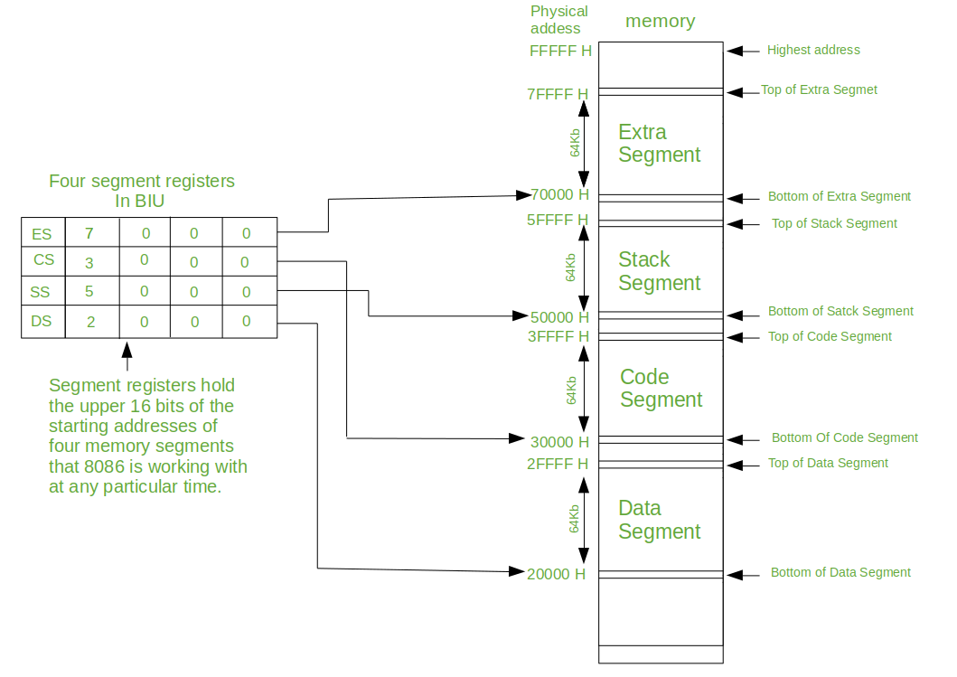
Positioning four 64 kilobyte segments within the 1M byte memory space
8086 - Memory Segmentation

Slide 9
Types of Segmentation
Overlapping Segment
  A segment starts at a particular address and its maximum size can go up to 64 kilobytes, but if another segment starts along this 64 kilobytes location of the first segment, then the two are said to be Overlapping Segment
Non-Overlapped Segment
  A segment starts at a particular address and its maximum size can go up to 64 kilobytes, another segment should not start before this 64 kilobytes location of the first segment, then the two segments are said to be Non-Overlapped Segment
8086 - Memory Segmentation

Slide 10
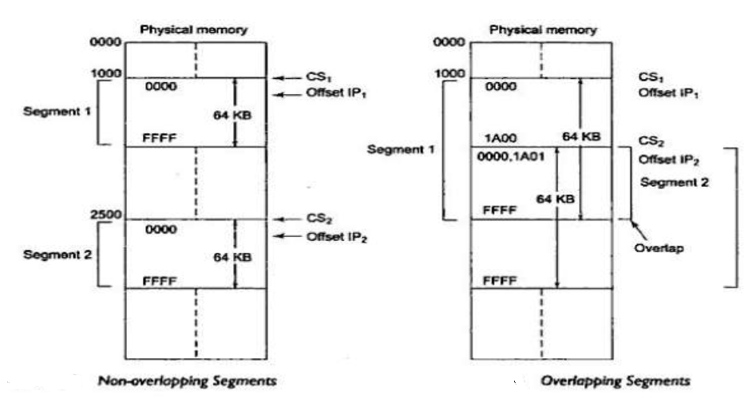
Types of Segmentation
8086 - Memory Segmentation

Slide 11
Thank you . . .
8086 - Memory Segmentation

